Slide 1

Financial Sales & Profitability Performance

Slide 2


Key Performance Indicators
Financial Overview
Strong Bottom-line Result: Generated $16.89M in total net profits, indicating highly efficient operations.
Healthy Profit Margin: Maintained an overall profit margin of 14.23% across all transactions.
Total Sales
Volume Leaderboard: Successfully distributed 1.13M units , demonstrating massive logistics scale.
Market Growth: Recorded a robust sales growth rate of 11.24% year-over-year.

Slide 3


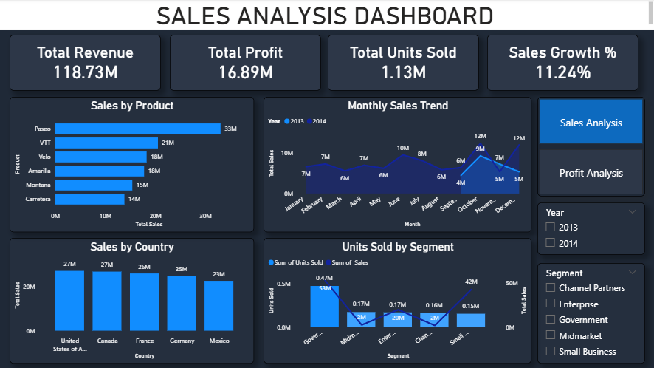
Dashboard View: Sales Analysis
Sales Performance Summary
Product Distribution: Paseo is the primary top-line driver, contributing $33M in total sales. VTT is second at $21M, followed by Velo and Amarilla both generating $18M.
Geographic Balance: Sales volumes remain extremely well balanced internationally. The United States and Canada lead sales at $27M each, with France ($26M) and Germany ($25M) following closely behind.
Paste Sales Dashboard Screenshot Here
Capture Page 1 of "DASBOARD 3.pdf"
Seasonality Trend: Strong Q4 performance peak observed in October ($17M sales spike), followed by a steady finish in November ($11M) and December ($13M).

Slide 4
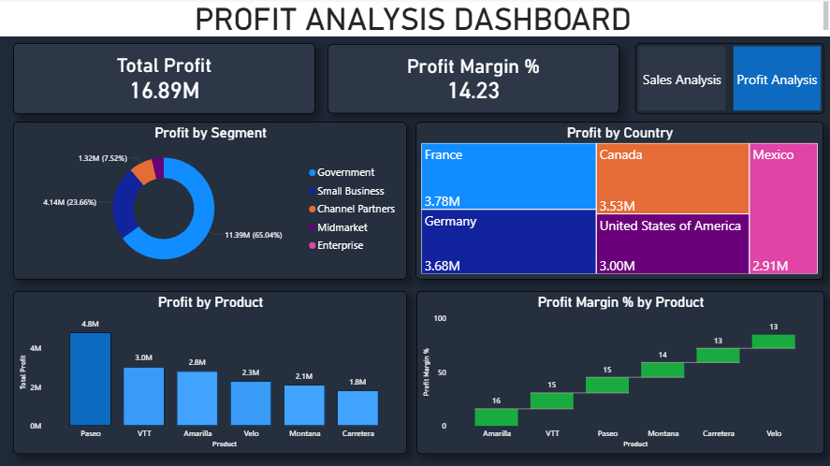
Dashboard View: Profit Analysis
Profitability Performance Summary
High Net Contribution: Government represents the highest absolute segment profit driver, accounting for $11.39M (65.04% of total mix). Small Business provides $4.14M (23.66%).
Margin Leader: While Paseo leads in absolute profit ($4.8M), Amarilla achieves the highest individual profit margin percentage at 16%, closely followed by VTT (15%).
Paste Profit Dashboard Screenshot Here
Capture Page 2 of "DASBOARD 3.pdf"
Country Margins: France and Germany represent the most cost-efficient operational centers, leading with profit margins of 14.54% and 14.72% respectively, outperforming the high-volume US market (11.11%).

Slide 5

Strategic Segment & Product Mix
Product Profit Efficiency
Customer Segment Dynamics
Paseo Leading Value: Generates the largest portion of absolute profits ($4.8M) on a stable 15% margin foundation.
→
Government Dependency: Represents 65.04% of global profitability. A critical recurring customer anchor.
→
VTT Strong Yield: Drives $3.0M of total profits, displaying reliable 15% margin consistency.
→
Small Business Focus: Contributes 23.66% of total profitability ($4.14M). Highly strategic growth engine.
→
→
Amarilla High-Efficiency: Achieves a peak 16% margin yield on smaller volume scale, earning $2.8M.
→
Channel Partnerships: Represents 7.52% ($1.32M) of profit mix with optimized operational footprint.
→
Carretera Lagging: Lowest margin performer (13%), representing a key cost-containment focus area.
Enterprise/Midmarket: Less than 4% total profit combined, representing low penetration or high cost-to-serve.
→

Slide 6
Conclusion
Core Profitability Outlook
Operations demonstrate a highly efficient 14.23% net margin, anchored by the Government segment's 65.04% contribution and the high-yield performance of the Paseo and Amarilla product lines.
Growth Opportunities
• Small Business Expansion: Accelerate the strategic growth engine currently delivering $4.14M in profits.
• Margin Optimization: Apply Amarilla's high-efficiency model (16%) to lagging product lines.
• Regional Scaling: Leverage efficient European hubs (France/Germany) to bolster North American margins.

Slide 7
THANK YOU

